Slide 1
Overfitting and underfitting
By
ANJALI KADRE

Slide 2
BIAS AND VARIANCE
BIAS:
The bias is known as the difference between the prediction of the values by the ML model and the correct value.
Bias means error of training data
VARIANCE:
Variance is the change in prediction accuracy of ML model between training data and test data.
Variance means error in testing data

Slide 3
GENERALISED MODEL
Generalized model is also called as Good model.
In Generalized model accuracy during training as well as testing is very high.
Performance during training and testing dataset is good.
Generalized model has low training and low testing error.
It has low bias and low variance.
Good Model or Most Generalised Model.
Training Error - 1%
Testing Error - 1%

Slide 4
WHAT IS OVERFITTING?
Accuracy during training is very high but accuracy during testing is very low then this condition is called overfitting.
It is able to perform well on training dataset but it does not perform well on testing dataset.
Low Training error
High Testing Error
Low Bias
High Variance
Training Error - 1%
Testing Error - 25%

Slide 5
WHAT IS UNDERFITTING?
Accuracy during training is very low but accuracy during testing is very high then this
condition is called overfitting.
It is does not perform well on training dataset as well as on testing dataset.
High Training error
High Testing Error
High Bias
High Variance
Training Error - 20% | Testing Error - 20%

Slide 6
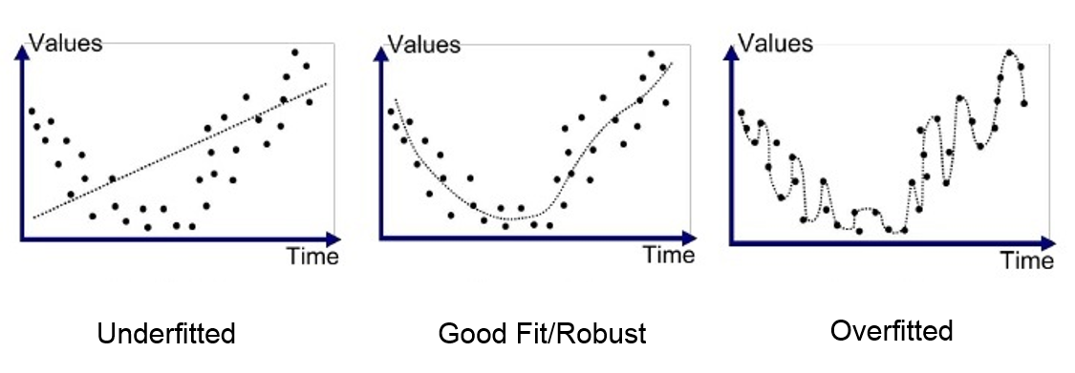

Slide 7
WHAT IS BIAS AND VARIANCE TRADEOFF?
When there is a huge bias it means the model has not learned the relevant relationship between the features and the target values. This is also called as Underfitting. And, when there is a high variance it means that the model has learned the data well so that it includes the noise. This is also called Overfitting.
We need to have a model that is neither underfitting and nor overfitting. which is called as
Bias-Variance trade-off.
If there is no balance between variance and bias then the model will not be able to generalize a failure
to perform well on new data.

